Slide 1



PROPOSAL–Detailed Project Report
COMPETITIVE INTELLIGENCE STUDY –A GLOBAL COMPANY OPERATING IN SURFACE TREATMENT
Prepared For :
Dated: March 1, 2021
TSR/2020/268
MARKET INTELLIGENCE . CONSULTING
www.techsciresearch.com

Slide 2
Proposal Flow
Contents
Background……………………………………………………………………………………………………………………………………................3
Scope of Work…………………………………………………………………………………………………………………………………………….4
Research Methodology………………………………………………………………………………………………….............................................12
Project Execution Plan…………………………………………………………………………………………………………………………….........14
Project Deliverables……………………………………………………………………………………………………………………………………..15
Project Organization……………………………………………………………………………………………………………………………………..16
Communication Plan……………………………………………………………………………………………………….........................................17
Investment Figures……………………………………………………………………………………………………………………………………….18
About TechSci Research……………………………………………………………………………………………………….……………….............19

Slide 3

Background
Global Information, Inc. (GII) is a leading search engine, offering access to the largest online collection of industry, company and country reports available. The company is involved in providing research assistance services to various industries globally. The company’s services are used by some well renowned customers worldwide. GII has over 23 years experience serving clients worldwide with delivering reliable information to multinational client.
One of the client of GII is, a company is operating in surface treatment to serve a broad range of industries and keen to understand competitive insights about HEF Group
TechSci is submitting this proposal covering scope of work, methodology, timelines and other details

Slide 4
Scope of Report
Product/Service of Interest (POI): Target Businesses of HEF Group
The HEF Groupe is a world leader in surface engineering, capable of proposing to its customers, large accounts or SMBs, a total service ranging from research, through industrial development and technology transfer, to the utilization of processes or the supply of components.
HEF Durferrit, and of its custom treatment network, Techniques Surfaces are in more than about twenty countries.
HEF's key expertise is in tribology and functionalization of surfaces, thermochemical treatments and controlled liquid ionic nitriding treatments (CLIN®), PVD - PACVD vacuum deposition, such as DLC (Diamond-Like Carbon) and the other mechanical and tribological layers and Friction rings and components. Relevant URLs are https://www.hef.fr/en/accueilen.html; https://www.hef.fr/en/Presentation.html;
https://www.hef.fr/en/HEFfigures.html
Target Business: THERMOCHEMISTRY- NITRIDING
Nitriding is a heat-treating process that diffuses nitrogen into the surface of a metal to create a case-hardened surface. These processes are most used on high-carbon, low-alloy steels. They are also used on medium and high-carbon steels, titanium, aluminium and molybdenum. The various treatments patented and marketed by the HEF Group under the names ARCOR®, TENIFER®, TUFFTRIDE®, MELONITE®, NUTRIDE® or QPQ® are grouped together under the family name CLIN which stands for Controlled Liquid Ionic Nitrocarburizing.
The CLIN treatments together with the associated industrial equipment have easily adapted to the various environmental and technical constraints and their applications are being developed all the time in industry.
These treatments concern mainly ferrous alloys (steel, cast iron, stainless steel, etc.) and are carried out between 500°C and 630°C.
The aim of CLIN treatments is, from a heterogeneous surface reaction, to transfer into the solid metal alloy nitrogen and carbon atoms contained in the molten salt.
In addition to the ARCOR V and ARCOR N treatments, 3 new treatments have been developed in recent years, i.e. ARCOR DT, ARCOR L and ARCOR CS.
Those treatments allow combining corrosion, wear and tiredness resistance properties of steels and cast-irons. Corrosion resistance can exceed 700 hours in salt spray on simple parts and can commonly reach 400 hours in salt spray on more complex parts

Slide 5
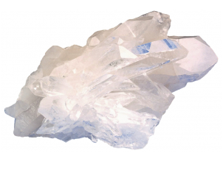
Scope of Report
Product/Service of Interest (POI): Target Businesses of HEF Group
Target Business: Salt Bath Heat Treatment
The wide variety of HEF Durferrit salts can be used in molten form within a temperature range of 150°C to 1300°C.
Salts for nitrocarburizing
Salts for carburizing and carbonitriding
Solid carburizing products
Salts for annealing and hardening
Salts for the heat treatment of high-speed steels
Salts for quenching and tempering
Thermochemical cleaning of metallic surfaces
Salts for vulcanizing
Salts for aluminium heat treatment
Salts for blackening
Boriding products
Stop-off compounds

Slide 6
Scope of Report
Product/Service of Interest (POI): Target Businesses of HEF Group
Target Business: VACUUM DEPOSITION - PVD/PACVD
Physical vapour deposition and plasma-assisted chemical vapour deposition (PVD and PACVD) are environmentally friendly vacuum deposition technologies involving a deposition of material on the surface of the parts to be treated.
They make it possible to obtain coatings having:
• Thicknesses which can vary from several nanometres to several tens of microns
• Hardnesses ranging from 1,000 to 4,000 HV
Depending on the coating chosen, they thus give the parts treated:
• Tribological properties: very low coefficient of friction
• Mechanical properties: very high hardness
• Electromagnetic shielding properties
• Optical properties
• Electrical conductivity properties
• Antibacterial properties
• Decorative properties
HEF mainly uses 3 methods to generate its plasmas and produce high-quality layers:
• PEMS®:PEMS® permits the production of very dense layers for tribological use. This process is more particularly used by HEF to produce its low coefficient of friction hard or extra-hard layers. Moreover, PEMS® makes it possible to modify the hardness, the density and resistance of deposits to suit the application.
• CAM®:: At the cutting edge of vacuum technology, CAM® constitutes a genuine evolution, permitting the deposition of hard and very low coefficient of friction coatings at an extremely low temperature.
• M-ARC®: This method is an evolution of the usual arc evaporation technique. It considerably reduces the droplets generally associated with this type of coating.

Slide 7
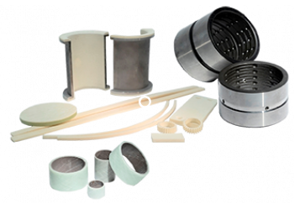


Scope of Report
Product/Service of Interest (POI): Target Businesses of HEF Group
Target Business: BUSHINGS / JOINTS
HEF DURFERRIT has developed a full range of bushings allowing it to meet the diverse needs of its customers.
The original bushing developed and implemented by the HEF group was based on the use of special surface treatments and special surface geometries (grids, cavities ..) .These steel bushings were quickly recognized for their ability to operate under high pressure and vibration in harsh environments (abrasion, shocks, corrosion).
HEF steel bushings are commonly used in construction equipment, agriculture, steel industry, cement industry, glassware.
Composite bushings came more recently, allowing HEF DURFERRIT bushings range to meet the new needs of designers and users:
These composite bearings work without lubrication and under severe conditions. They were quickly adopted for their high tribological performance, low coefficient of friction and lifetime in various applications such as handling, agriculture equipment , hydraulic turbines
All technologies (topography, processing , materials ) implemented on the bushings are adaptable on different products, such as slides, washers, spherical bushings...

Slide 8
Scope of Work
S. No. | Contents | Contents
1. | Research Methodology | Research Methodology
2. | Executive Summary | Executive Summary
Business Performance | Business Performance
3. | Industry Size and Market Share of HEF Group
 | 3.1. |  | Global Market, Million USD, 2020
 |  |  | 3.1.1 | Nitriding
 |  |  | 3.1.2 | Bath Salts For Heat Treatment
 |  |  | 3.1.3 | Vacuum Deposits PVD / PACVD
 |  |  | 3.1.4 | Bushings / Joints
 | 3.2. |  | Regional Market, Million USD, 2020
 |  |  | 3.1.1 | Nitriding (Europe, North America, South America, Asia, Others)
 |  |  | 3.1.2 | Bath Salts For Heat Treatment (Europe, North America, South America, Asia, Others)
 |  |  | 3.1.3 | Vacuum Deposits PVD / PACVD (Europe, North America, South America, Asia, Others)
 |  |  | 3.1.4 | Bushings / Joints(Europe, North America, South America, Asia, Others)
 | 3.3. |  | Global Market Share of HEF Group, %, 2020
 |  |  | 3.1.1 | Nitriding Chemicals
 |  |  | 3.1.2 | Bath Salts For Heat Treatment
 |  |  | 3.1.3 | Vacuum Deposits PVD / PACVD
 |  |  | 3.1.4 | Bushings / Joints
 | 3.4. |  | Company Organization Charts Covering From HEF Headquarter To Regional Branch Offices
 | 3.5. |  | Regional Market Share Million USD,% 2020
 |  |  | 3.5.1 | Nitriding (Europe, North America, South America, Asia, Others)
 |  |  | 3.5.2 | Bath Salts For Heat Treatment (Europe, North America, South America, Asia, Others)
 |  |  | 3.5.3 | Vacuum Deposits PVD / PACVD (Europe, North America, South America, Asia, Others)
 |  |  | 3.5.4 | Bushings / Joints(Europe, North America, South America, Asia, Others)

Slide 9
Scope of Work
S. No. | Contents | Contents
Sales Performance | Sales Performance
4. | Current (2020) and Projected Sales (2025) of HEF of Each Business |  | Current (2020) and Projected Sales (2025) of HEF of Each Business
 | 4.1 |  | Global Sales of HEF Group, Million USD , 2020, 2025
 |  |  | 4.1.1 | Nitriding
 |  |  | 4.1.2 | Bath Salts For Heat Treatment
 |  |  | 4.1.3 | Vacuum Deposits PVD / PACVD
 |  |  | 4.1.4 | Bushings / Joints
 | 4.4. |  | Regional Sales of HEF Group, Million USD , 2020, 2025
 |  |  | 4.4.1 | Nitriding (Europe, North America, South America, Asia, Others)
 |  |  | 4.4.2 | Bath Salts For Heat Treatment (Europe, North America, South America, Asia, Others)
 |  |  | 4.4.3 | Vacuum Deposits PVD / PACVD (Europe, North America, South America, Asia, Others)
 |  |  | 4.4.4 | Bushings / Joints(Europe, North America, South America, Asia, Others)
Operational Details |  |  | Operational Related Details Nitriding Chemicals Business
5. | Nitriding Business |  | Nitriding Chemicals Business
 | 5.1 |  | Key Customers ( Up to 5 )
 | 5.2 |  | Typical Order Unit Price Per Customer | Typical Order Unit Price Per Customer
 | 5.3 |  | Typical Order Quantity Per Customer
 | 5.4 |  | Type / Number of Surface Treatment Equipment
 | 5.5 |  | Production Capacity and Factory Scale
 | 5.6 |  | Evaluation From The Market (Technical, Service, Etc.)
 | 5.7 |  | Organization Structure Highlighting Departments with Specific Focus on Sales | Technology superiority (including comparison with our company)
 | 5.8 |  | Technology Superiority (including comparison with the client company)

Slide 10
Scope of Work
S. No. |  | Contents
Operational Details |  |  | Operational Related Details Nitriding Chemicals Business
6. |  | Bath Salts For Heat Treatment Business | Nitriding Chemicals Business
 |  | 6.1 | Key Customers ( Up to 5 )
 |  | 6.2 | Typical Order Unit Price Per Customer
 |  | 6.3 | Typical Order Quantity Per Customer
 |  | 6.4 | Type / Number of Surface Treatment Equipment
 |  | 6.5 | Production Capacity and Factory Scale
 |  | 6.6 | Evaluation From The Market (Technical, Service, Etc.)
 |  | 6.7 | Organization Structure Highlighting Departments with Specific Focus on Sales
 | 6.8 |  | Technology Superiority (including comparison with the client company)
7. |  | Vacuum Deposits PVD / PACVD Business | Nitriding Chemicals Business
 |  | 7.1 | Key Customers ( Up to 5 )
 |  | 7.2 | Typical Order Unit Price Per Customer
 |  | 7.3 | Typical Order Quantity Per Customer
 |  | 7.4 | Type / Number of Surface Treatment Equipment
 |  | 7.5 | Production Capacity and Factory Scale
 |  | 7.6 | Evaluation From The Market (Technical, Service, Etc.)
 |  | 7.7 | Organization Structure Highlighting Departments with Specific Focus on Sales
 |  | 7.8 | Technology Superiority (including comparison with the client company)
8. |  | Bushings / Joints Business | Nitriding Chemicals Business
 |  | 8.1 | Key Customers ( Up to 5 )
 |  | 8.2 | Typical Order Unit Price Per Customer

Slide 11
Scope of Work
S. No. | Contents
Operational Details |  | Operational Related Details Nitriding Chemicals Business
 | 8.3 | Typical Order Quantity Per Customer
 | 8.4 | Type / Number of Surface Treatment Equipment
 | 8.5 | Production Capacity and Factory Scale
 | 8.6 | Evaluation From The Market (Technical, Service, Etc.)
 | 8.7 | Organization Structure Highlighting Departments with Specific Focus on Sales
 | 8.8 | Technology Superiority (including comparison with the client company)
9. | Conclusions
Note: TechSci assumes that Client company will provide their details Related to Chapter 5.8, 6.8,7.8 and 8.8
Disclaimer : TechSci will try best to cover all set of the required information. The level of granularity may vary as the nature of information required, are sensitive and confidential

Slide 12

RESEARCH METHODOLOGY

Slide 13









Research Methodology
The recommended methodology for this study is based on exhaustive Secondary Research followed by extensive Primary Research. TechSci Research will deploy a dedicated team who will work dedicatedly for the Client to meet research objectives.
Phase-I: Secondary Search
The team will conduct exhaustive secondary research to collect the information on required set of data /information.
Phase-II: Formulating Questionnaire & Developing List of Respondents
Post Secondary Search, TechSci will prepare a list of target individuals in target group and related companies across different functions and levels in different geographies. In-addition, TechSci will also identify individuals in competitors and customers
TechSci team will formulae guidelines to ask specific questions related with the project objectives.
Phase-III: Extensive Primary Search
TechSci Research will execute primary surveys targeting identified individuals in these target companies including their competitors and customers through Telephonic methodology. TechSci Research will perform periodical checks on data collected through telephonic surveys with logic checks and analyze survey results.
Phase IV:
TechSci will deliver the final comprehensive project report in detailed PDF format.
Target Audience Identification
Questionnaire Design and Finalization
Survey Execution
Data Cleaning and Validation
Survey Analysis
Reporting

Slide 14
Project Execution Plan
Interim Report
Final Report
Weeks With | 1 | 2 | 4 | 5 | 7
Project Initiation
Project team set-up
Project kickoff meeting with key stakeholders
Content and report generation
Data collection & research
Template development
Contact list development
Develop and validate the discussion guide for the market size, competitive benchmarking, and others )
Primary interviews among all industry participants
Collect and validate data from primary data source
Report writing
Analysis & Deliverable
Interim deliverable
Final deliverable
Completion & Follow up
Note:
The above-mentioned timelines do not include time required by Client’s/GII management for approval of questionnaires, feedback on interim reports, setting up meetings between Client/GII and TechSci Research because it would depend upon the availability of Client’s/GII management.

Slide 15
Project Deliverables
SCHEDULE OF DELIVERABLES:
Format | Deliverable type | Total Timeline (in weeks)
PPT/PDF | Interim report | 5
PPT / PDF | Final report | 7
Teleconference at commencement of the study, where the client/GII will confirm the research outline and finalize dates.

Slide 16
Project Organization
GII Contact
Name | Project Role | Contact Information
Isomi Shimoda | Client Contact | Mob: 81-44-952-0102 Email: shimoda@gii.co.jp
TechSci Research Contact
Name | Project Role | Contact Information
Mr. Karan Chechi | Project Mentor | Mob: +91 9899114448
 |  | Tel: +91.120.452.3901
 |  | E-mail: karan.chechi@techsciresearch.com
Mr. Vikas Yadav | Consultant | Mob: +91 9560913535
 |  | Tel: +91.120.452.3954
 |  | E-mail: vikas.yadav@techsciresearch.com

Slide 17

Communication Plan
Our communications plan consists of a series of planned communications (both written and verbal) – to make certain that all parties are kept fully informed during the course of project. In addition to these planned communications, ad-hoc communications will occur throughout the project; using email, phone, and instant message for this purpose. Contact information for the GII/ Client and Supplier Research Consultant will be finalized during the study kick-off.
Project Kick-off: At the beginning of the project, Supplier will conduct a conference call with the company, which we refer to as the Project Kick-off. The purpose of this meeting is to discuss the scope of the project thoroughly. In this discussion, we will finalize the project objective, scope, methodology, deliverable format, project schedule including any interim deliverables, and communications plan, and their schedule and process.
Project Status Report: Supplier will prepare an overall project update on a regular (generally once a week) basis. This will be written in email format and will include an overview of the status of the project and the immediate action points. The days and timings of the Project Status Report and subsequent Project Status Conference Calls will be decided upon during the Project Kick-off.
Project Status Conference Call: The Project Status Conference Calls are held on a scheduled basis (generally weekly) the day following receipt of the Project Status Report. During these discussions, supplier and client/GII review the status of the project and address any issues that may have arisen.
Project Status Conference Call Summary: After each Project Status Conference Call, Supplier will send a summary of the discussion to all the participants via email.

Slide 18
Investment Figures
TechSci Research estimates that total investment figure is:
Scope | USD
COMPETITIVE INTELLIGENCE STUDY -A GLOBAL COMPANY OPERATING IN SURFACE TREATMENT | 9,800 (exclusive of GII’s margin)
The above-mentioned price includes all the elements involved in conducting project, such as project preparation, questionnaire designing, primary research, time spent on desk research, project reporting and project deliverables.
PAYMENT SCHEDULE
Stages | Payment Schedule | Payment, US$
Overall Project Scope | Initiation of the study | 50%
 | Final report submission | 50%

Slide 19












WE ARE TECHSCI RESEARCH
A global market research and consulting company focused on providing research and consulting services worldwide, spanning a range of industries.
We deliver our customers with high value market research and advisory services to identify new market opportunities, growth engines and innovative ways to capture the market. We support leading organizations for meeting strategic business goals and making informed business decisions.
www.techsciresearch.com
11
1000
+
+
Industries
Successful Projects
80
150
+
+
Countries
Professionals
AREAS OF FUNCTIONAL EXPERTISE
Automotive
Infrastructure
Chemicals
Oil & Gas
FMCG & Retail
Power
IT & Telecom
Consumer Durable
Industrial Automation
Water
Semiconductor

Slide 20
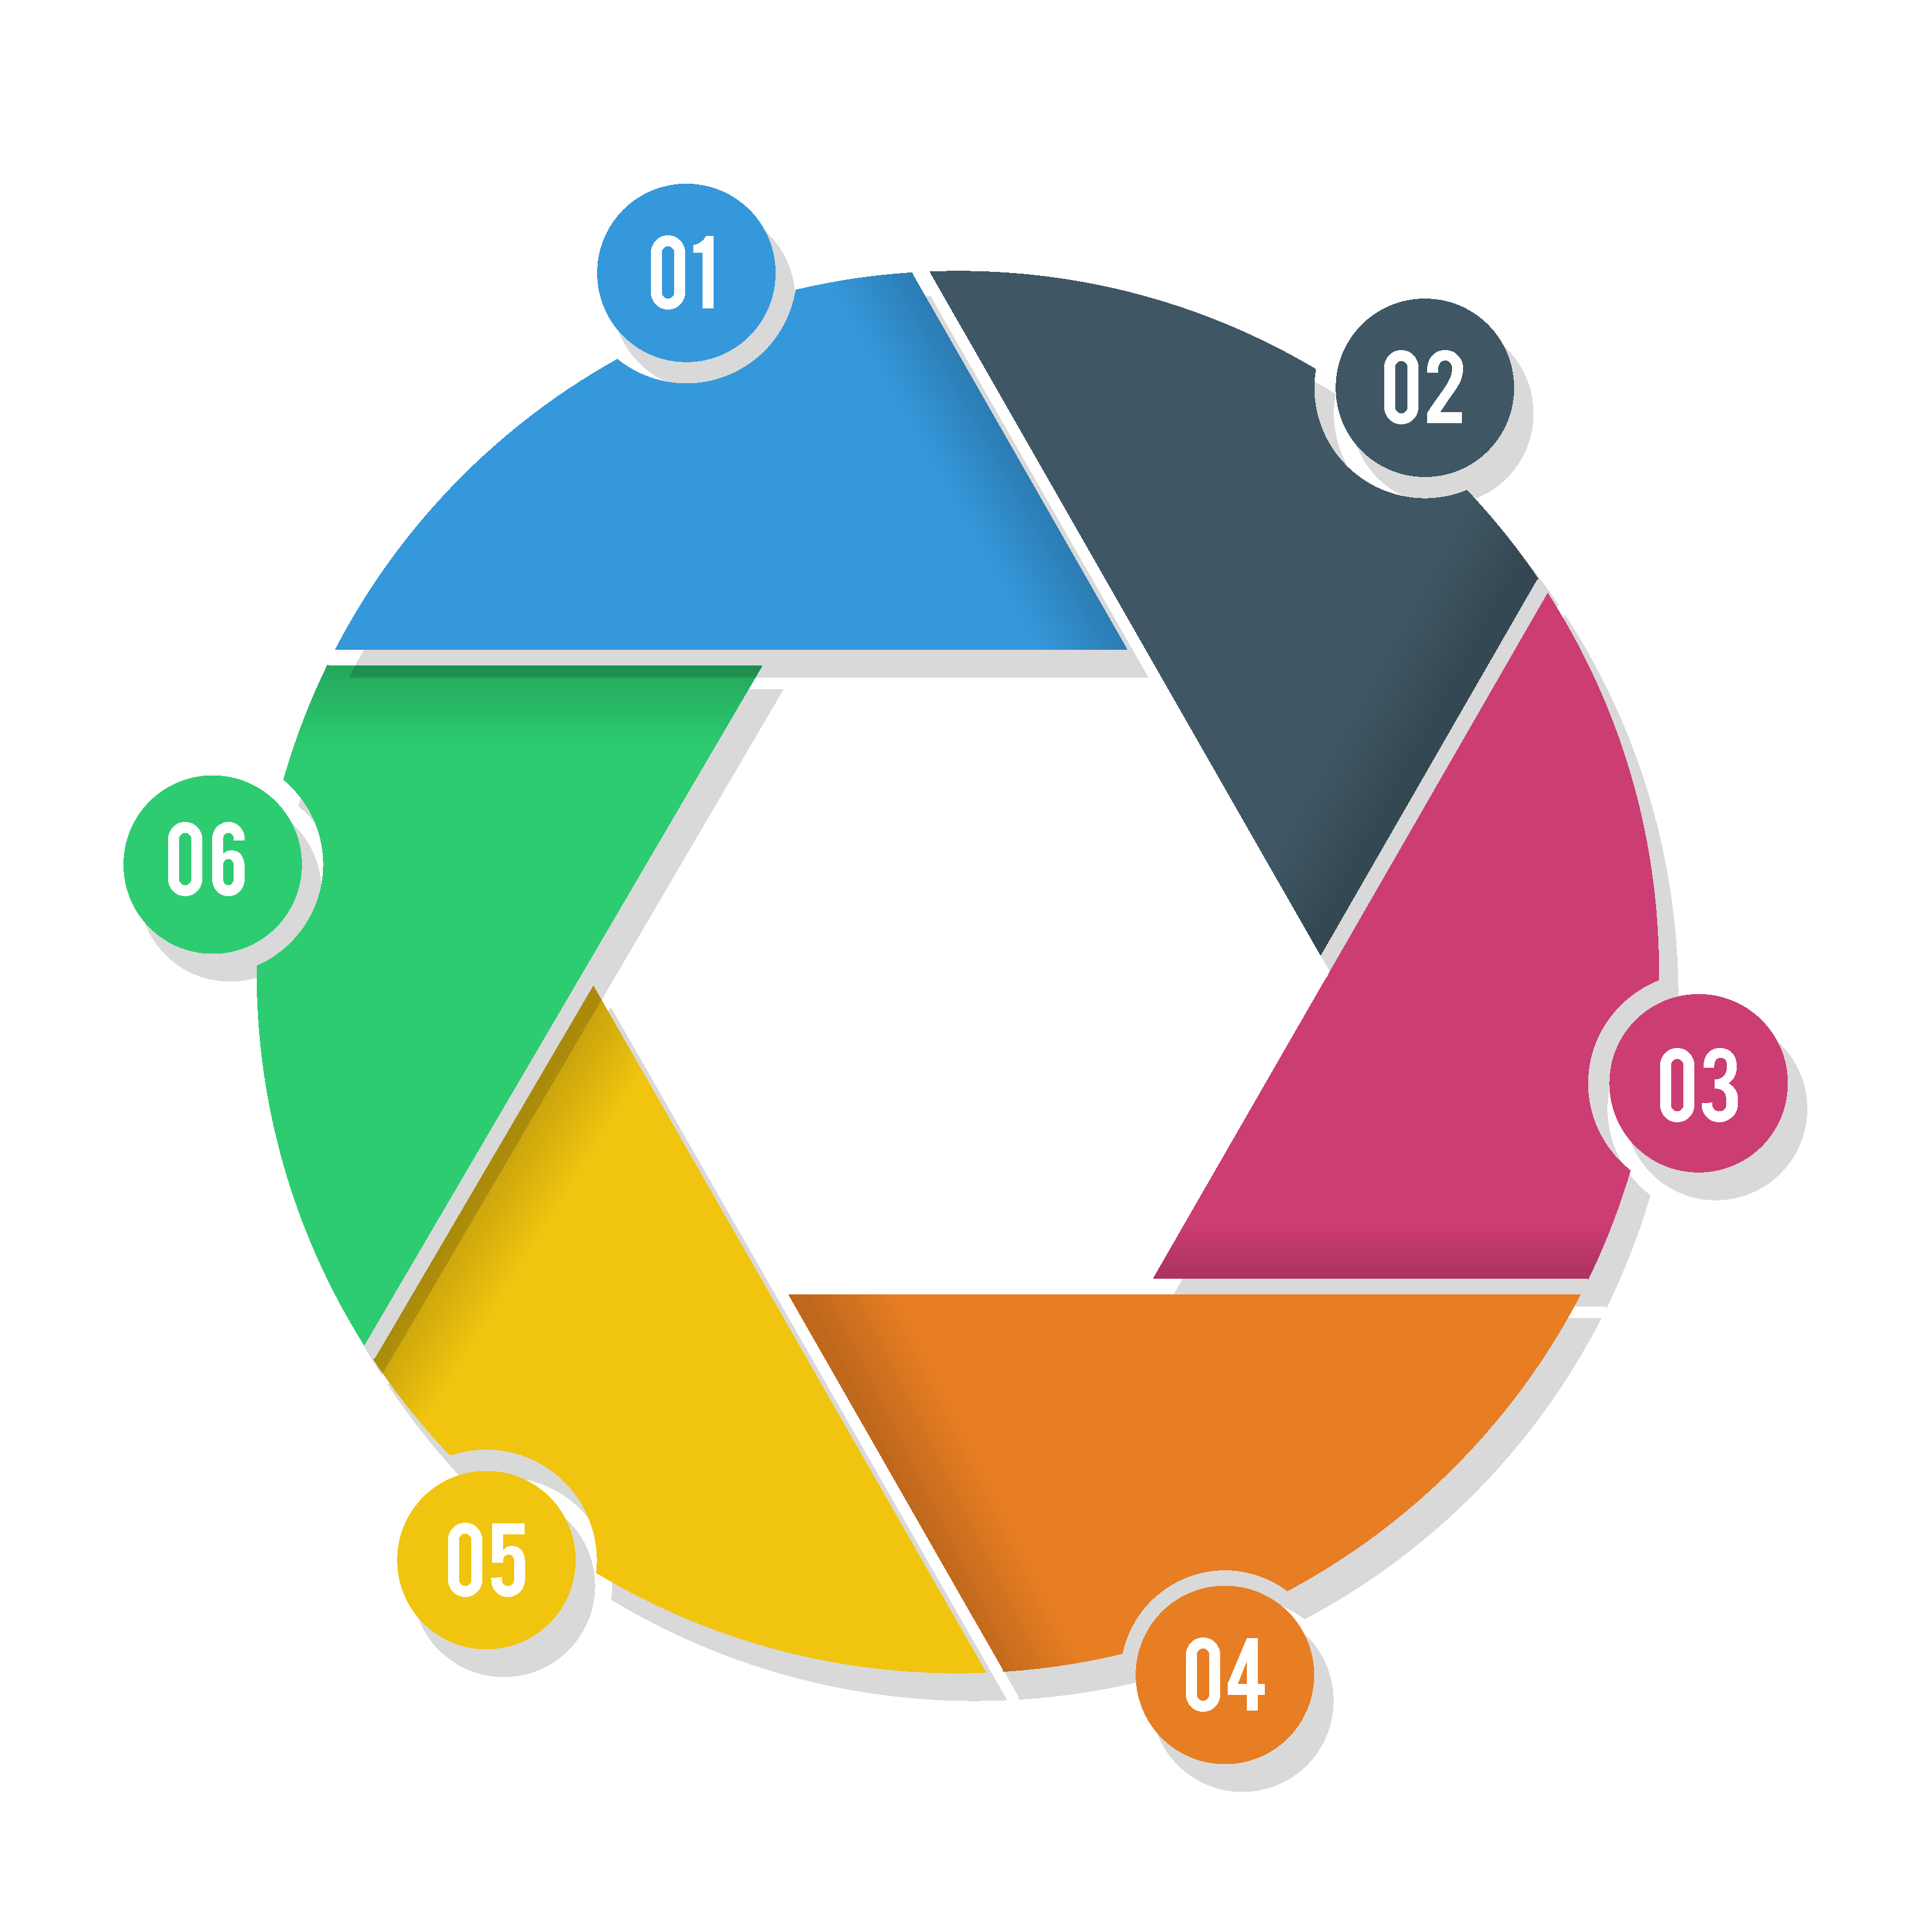






RESEARCH OFFERINGS ACROSS VALUE CHAIN
Market Landscaping
Need Gap/Pain Point Analysis
Market Size Estimation
Market Forecasting
Market
Exploration
Market
Potential
Pre & Post Communication
Advertising Effectiveness
Event/Promotion Effectiveness
New Product Testing
Price Sensitivity
Market Segmentation
Positioning &
Communication
Product and solution Development / Launch
Market
Response
Competitor
Tracking
Customer Satisfaction/ Tracking
Usage & Attitude
Brand Perception/ Tracking
Consumer Behavior Studies
Consumer/Shopper Insight
Competitive Intelligence
Competitors Profiling
Competitive Benchmarking

Slide 21
TechSci Advantage
More Market Research Value - Our prices are generally 35-60% lower than traditional market research providers for work our clients indicate is of equal or better quality, so our clients are able to increase their market research coverage without increasing their budget.
Speed & Flexibility - We harness the power and flexibility of our research model to deliver information faster and update data more frequently. Our clients benefit from unique solutions that can fit their company-specific market research needs.
Improved Research Efficiency & Utilization - Our model can help to increase the efficiency of internal market research divisions by helping our clients stretch their existing company resources and budget.
Comprehensive Coverage of Under-Researched Areas -TechSci's Research model enables us to profitably engage in projects focused on emerging markets and to cover exciting new markets and under-researched areas faster.

Slide 22
Robust Research Model
TechSci leverages a next-generation research model that fully harnesses new technologies and processes to streamline operations, automate research procedures and deliver insights in more interactive and engaging formats. Our cutting-edge research model leverages the following engines of innovation to deliver unique research value:
Offshoring - By tapping the capabilities of highly skilled professionals in emerging countries and supplementing the team with client-facing analysts in strategic worldwide locations, we cultivate a lower cost yet highly specialized, flexible and knowledgeable research team.
Industry Focus – With independent teams of experts in various industry sectors we keep a bull’s eye on the industry. Our team to specialize as experts in their domain, which combined with our research model, helps to deliver more value to our clients.
The Internet - The explosion of information transparency and availability enabled by the Internet provides an unprecedented tool for research innovation.
Technology – TechSci Research invests heavily in technology and maintains one of the industry’s highest technology employee-to-analyst ratios, enabling us to process information more quickly and deliver insights in more interactive and useful formats.

Slide 23

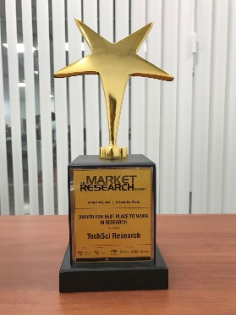
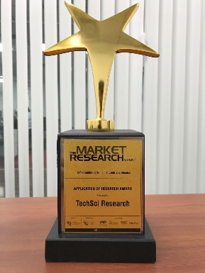
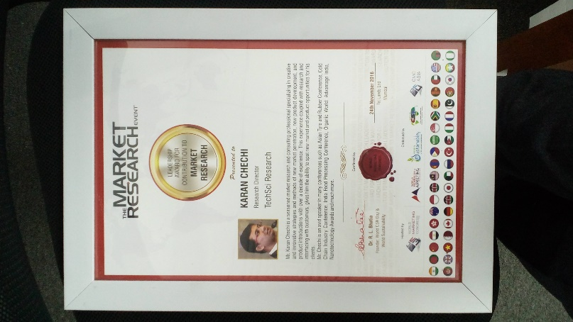
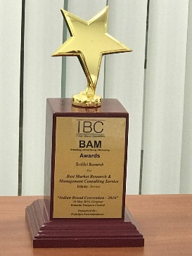
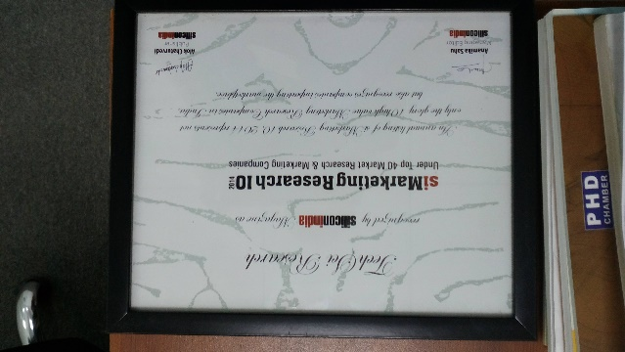
Awards & Recognitions
TechSci Research has secured a number of eminent awards and accolades. Some of the awards are mentioned here:
Recognition & Appreciation from WQIA
Award for Best Place to Work in Research by World Marketing Congress
Best Application of Research Award by World Marketing Congress
Leadership Award from World Marketing Congress
Best Market Research & Management Consulting Service by Wafisilpa Entertainments
Recognition from Silicon India Magazine

Slide 24
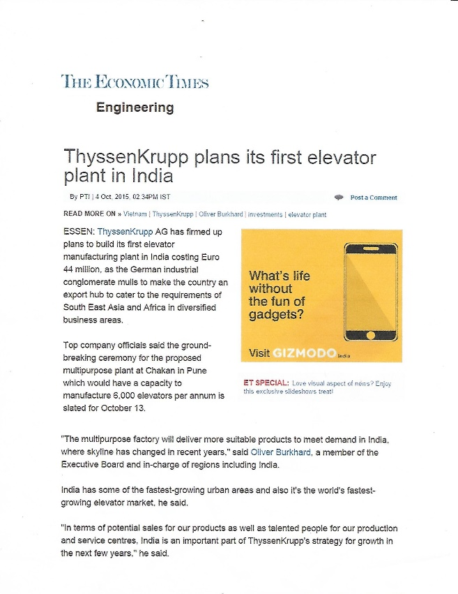
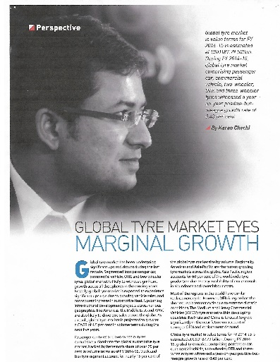
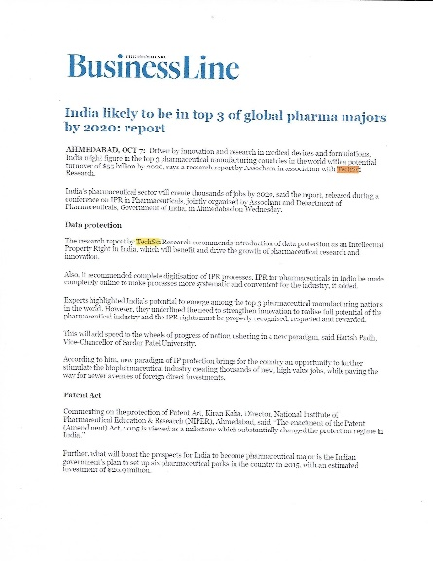
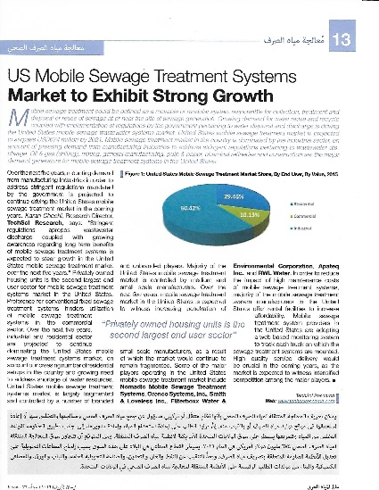

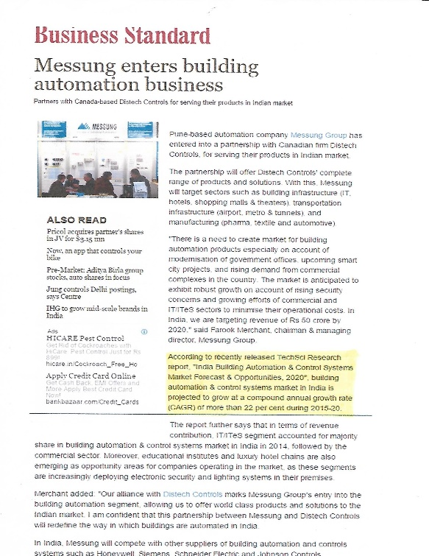
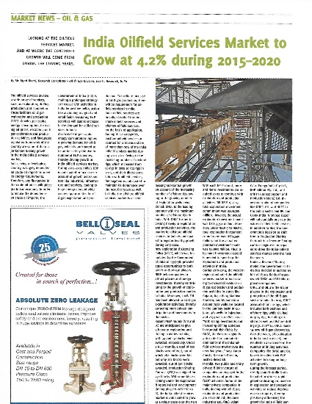
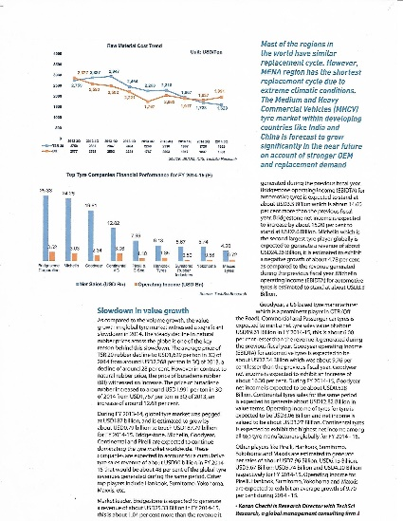





TECHSCI IN MEDIA
Our research findings have been widely covered by most prestigious and credible media houses across the world.

Slide 25
TESTIMONIALS
It was indeed a very good experience .TechSci was able to provide us with all the details that we were looking in the study. A special thanks to the team for the strong support throughout the enEnergy Storage System product launch journey.
Mr. Vivek Chopra
Product Development Team
DAGA GLOBAL India Pvt. Ltd.
Given the objective of the report was to understand overall opportunity landscape of Sensors, a more detailed explanation of the manufacturing process, value chain activities and player landscape have attributed higher value to the report.
Mr. Sameer Seth
Corporate Strategy
JK Organization
Market
Exploration
Market
Potential
Positioning &
Communication
I am satisfied with overall performance of TechSci Research. Weekly updates before the final report were especially helpful and reassuring. Additional requests on the content of the interim and/or final reports were handled in a swift and professional manner.
Mr. Shin Dosho,
Member Board of Directors,
Osaka Gas Co. Ltd
It’s a good piece of information when the company doesn’t have any information in the market as it combines qualitative & quantitative data. This why if I’m tasked to find data on an unknown market, I would probably contact you back.
Mr. Thomas Wiegele
Marketing Strategy
BSH Home Appliances
Product and solution Development / Launch
The quality of report was very good. The amount of time taken for the 10% free customization was a little long. The response was excellent.
Manager – Strategy
Shapoorji Pallonji and Co. Ltd.
Market
Response
Competitor
Tracking
I admit that TechSci’s in-depth knowledge on the market and also cooperation with face-to-face meeting was very helpful.
Mr. Eugene Kim
Financial Planning Division
LG Electronics

Slide 26

Thank you!!
We look forward to serving your research needs!!
TechSci Research – North America
708 Third Avenue, Manhattan,
New York, United States
Tel: +1- 646- 360- 1656
Email: sales@techsciresearch.com www.techsciresearch.com
TechSci Research – Europe
54, Oldbrook, Bretton,
Peterborough,
United Kingdom
Email: sales@techsciresearch.com www.techsciresearch.com
TechSci Research – Asia-Pacific
B – 44, Sector – 57, Noida, National Capital Region, U.P. - India
Tel: +91-120-4523900
Email: sales@techsciresearch.com www.techsciresearch.com

